Slide 1


IEEE SoutheastCon Hardware Competition
Nathan Gardner, Madison Kelly, Luke McGill, Mark Beech

Slide 2
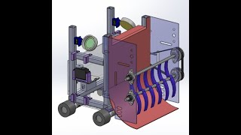
Demo
IEEE SECON 2023 Robotics Competition

Slide 3
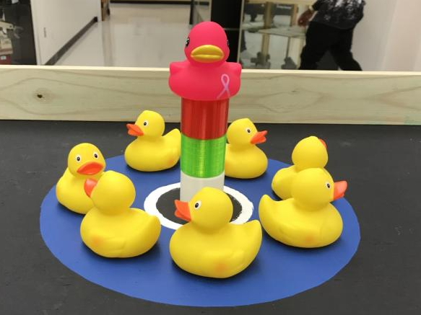
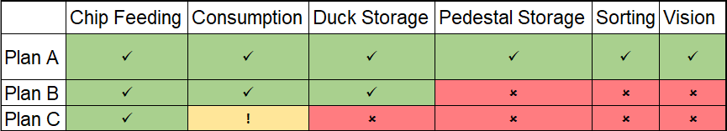
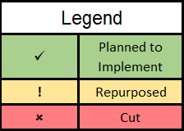
Plans vs Reality
Plans and multiple backup plans developed

Slide 4
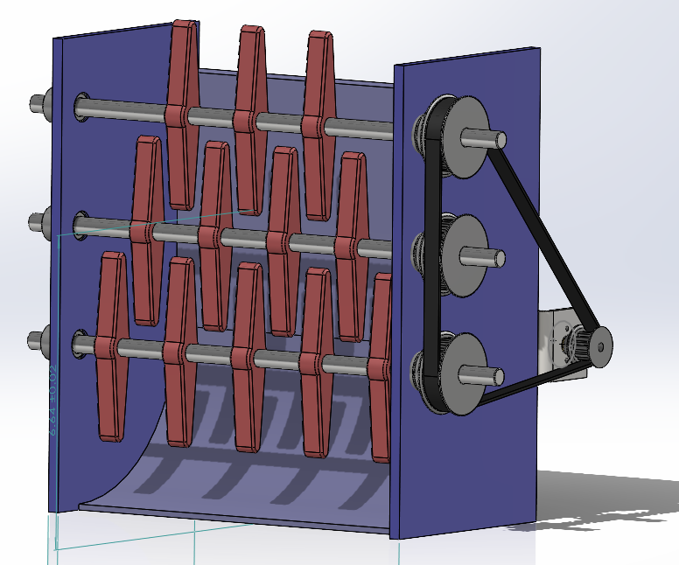
Consumption / Delivery

Slide 5
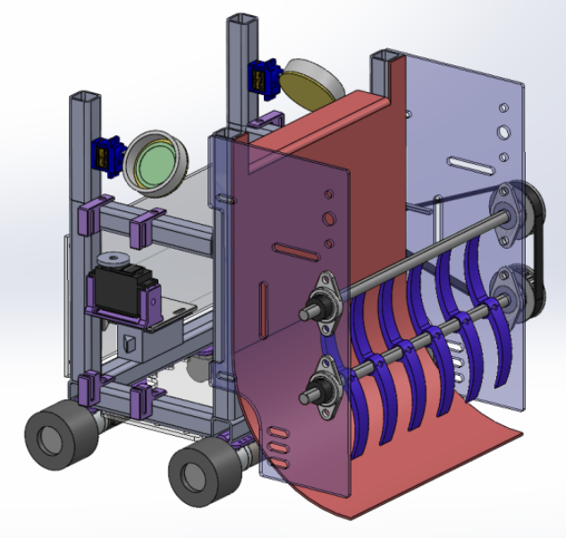
Consumption / Delivery

Slide 6
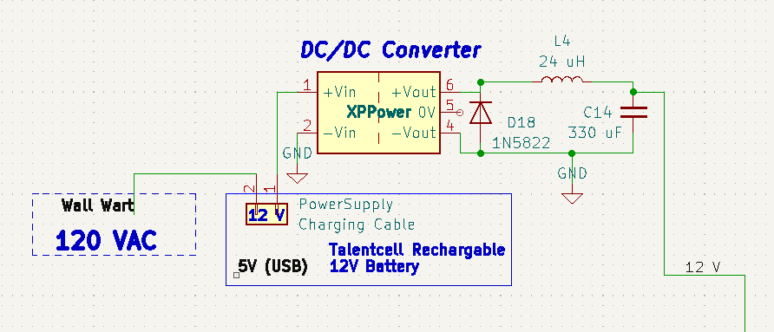
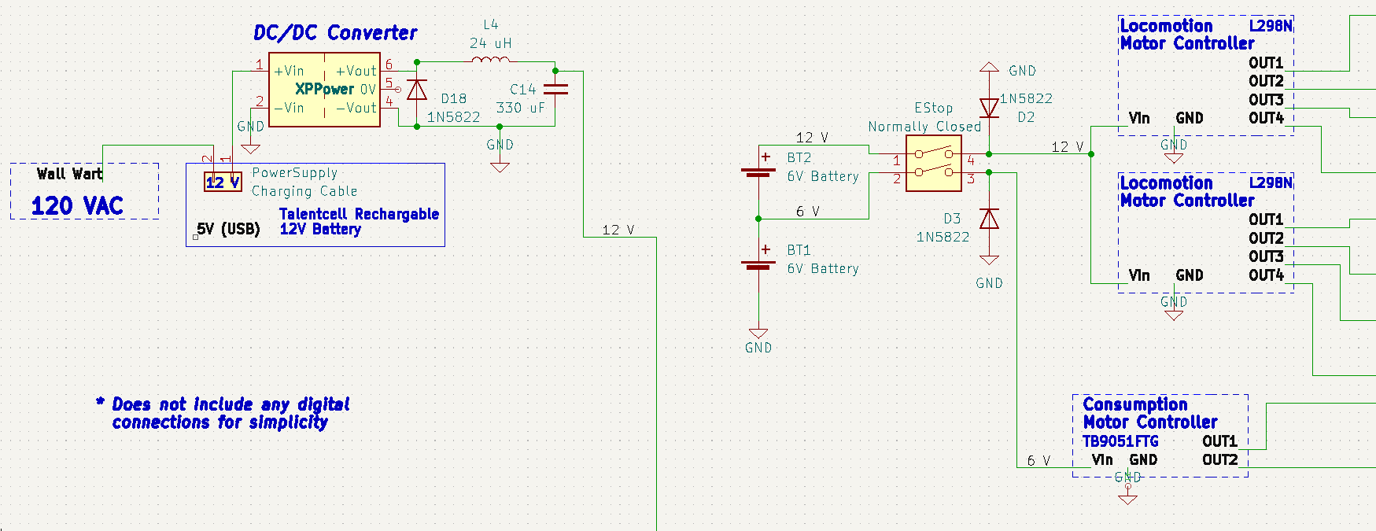
Power Subsystem

Slide 7
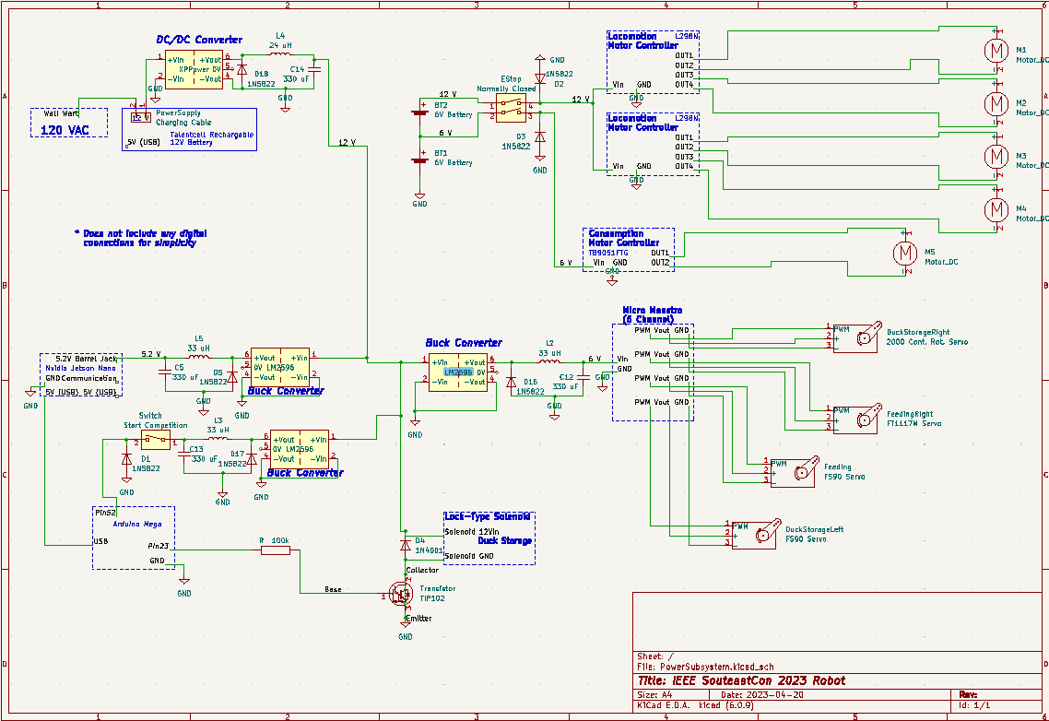

Slide 8
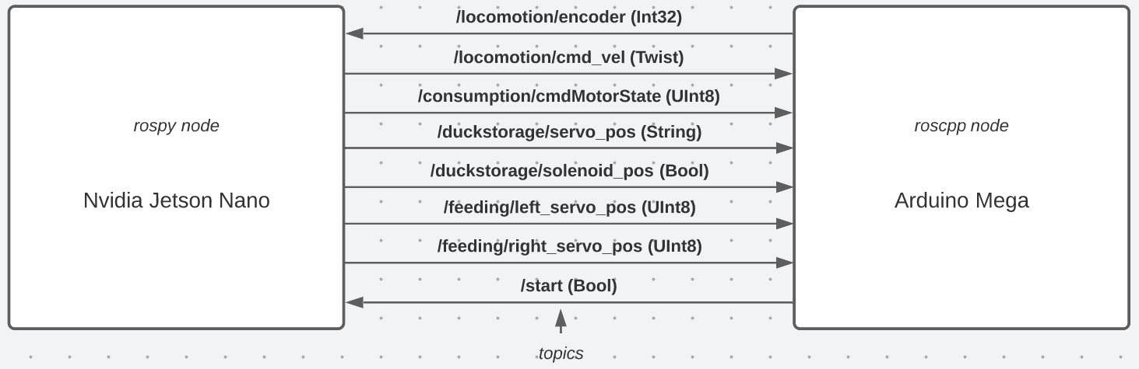
Software

Slide 9
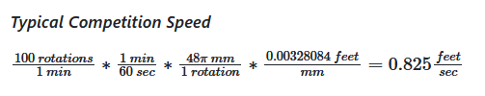
Path

Slide 10
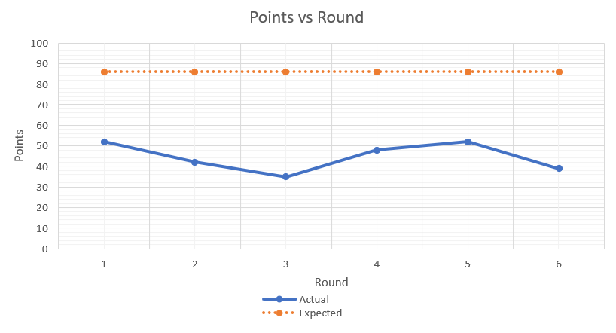
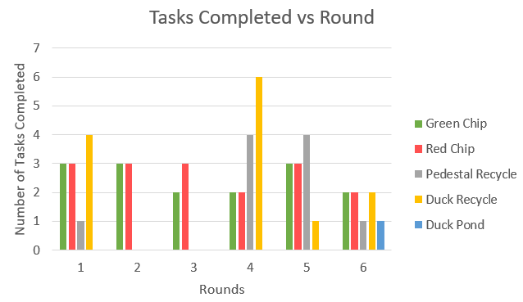
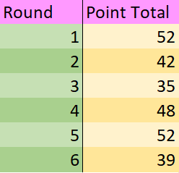
Experimentation and Validation
Figure 2
Figure 1
Figure 3

Slide 11
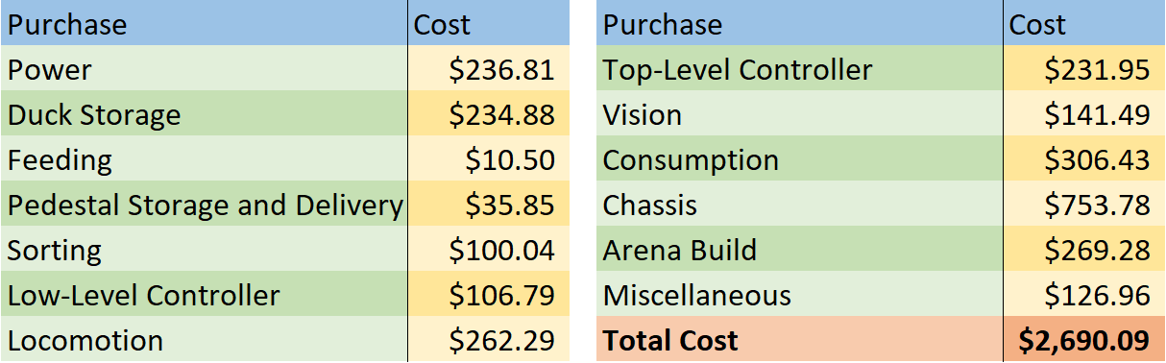
Budget
Budget includes R&D, build, and operations expenses

Slide 12
References
[1] ”NFPA 79,” NFPA 79: Electrical Standard for Industrial Machinery. [Online]. Available:https://www.nfpa.org/codes-and-standards/all-codes-and-standards/list-of-codes-and-standards/detail?code=79. [Accessed: 13-Oct-2022].
[2] “OSHA,” 1910.212 - General requirements for all machines. | Occupational Safety and Health Administration. [Online]. Available: https://www.osha.gov/laws-regs/regulations/standardnumber/1910/1910.212. [Accessed: 26-Apr-2023].
[3] ”The Federal Register,” Federal Register :: Request Access. [Online]. Available:
https://www.federalregister.gov/documents/2014/02/10/2014-02560/energy-conservation-program-energy-Conservation-standards-for-external-power-supplies.
[Accessed: 13-Oct-2022].

Slide 13
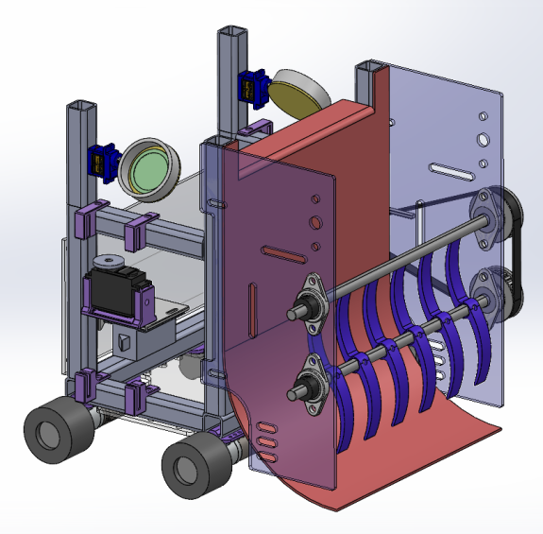
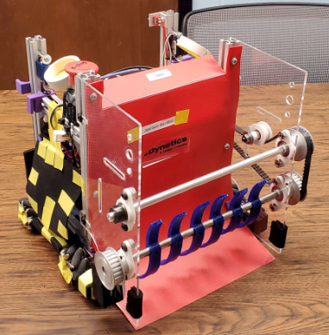
Questions?

